Slide 1

#LifeKoKaroLift
Data Science Certification Program

Slide 2


Course : Data Science
Lecture On : Data Visualization
Instructor : Shivani Kapania

Slide 3
In Last Class, we covered….
Introduction to visualization
Types of charts

Slide 4
Today’s Agenda
Introduction
Data visualization toolkit
Components of a plot

Slide 5
Matplotlib
Data visualization is very important in data science:
Making decisions
Reporting insights
Python 2D plotting library
Provides an object-oriented API

Slide 6
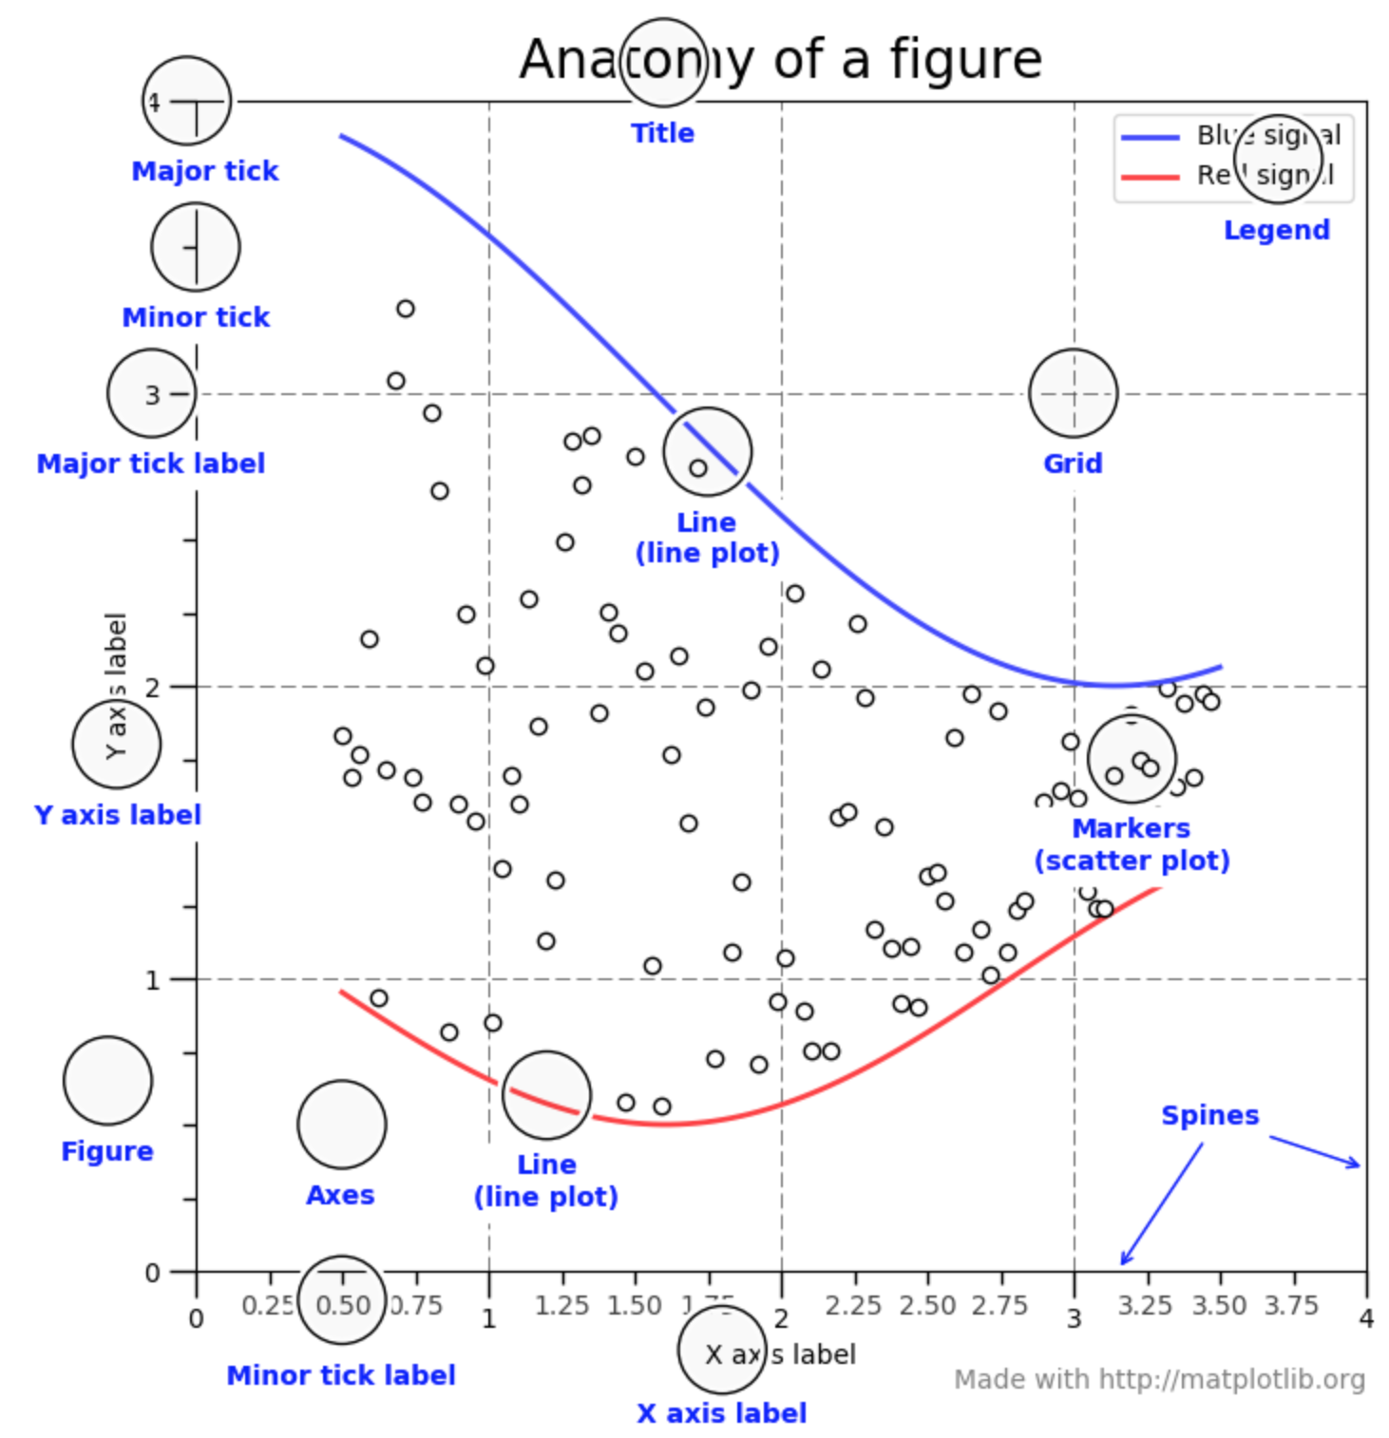
Matplotlib

Slide 7
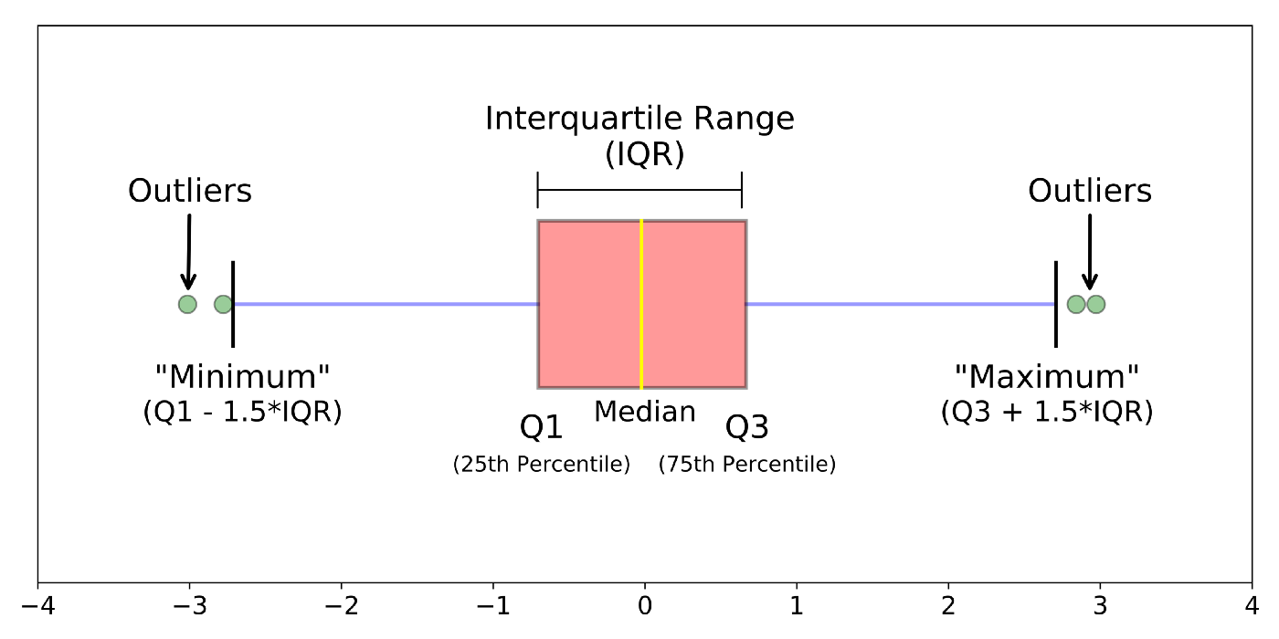
Boxplot
A boxplot is a standardized way of displaying the distribution of data based on a five number summary (“minimum”, first quartile (Q1), median, third quartile (Q3), and “maximum”).

Slide 8
#LifeKoKaroLift
Thank You!

